Slide 1
Quadrature Phase-Shift Keying (QPSK)
Presented by: Sayan Pal
Roll no.:16800117022
3rd Year CSE

Slide 2
CONTENT
Introduction of PSK
Types of PSK
BPSK
QPSK
QPSK Modulator
QPSK Demodulator
Applications of QPSK
Advantages & disadvantages of QPSK
Conclusion

Slide 3
Introduction to Phase-Shift Keying (PSK)
Phase-shift keying (PSK) is a digital modulation scheme based on changing, or modulating, the initial phase of a carrier signal. PSK is used to represent digital information, such as binary digits zero (0) and one (1).
PSK is typically applied in wireless local area networks (WLAN), Bluetooth technology and radio frequency identification (RFID) standards used in biometric passport and contactless payment systems.

Slide 4
Types of Phase-Shift Keying (PSK)
Two common PSK types are as follows:
1)Binary Phase-Shift Keying (BPSK): Simplest PSK type. Uses two phases separated by 180 degrees.
2)Quadrature Phase-Shift Keying (QPSK): Uses four phases to encode two bits per symbol.
More complex PSK schemes may use more than four phases for data transmission. However, eight is the maximum.

Slide 5
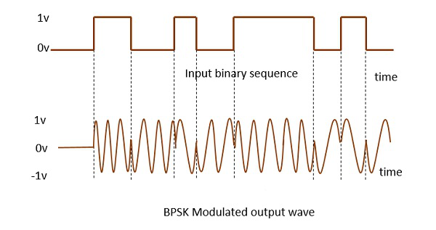
Binary Phase Shift Keying (BPSK)
This is also called as 2-phase PSK or Phase Reversal Keying. In this technique, the sine wave carrier takes two phase reversals such as 0° and 180°.
BPSK is basically a Double Side Band Suppressed Carrier(DSBSC) modulation scheme, for message being the digital information.
Resulting is the image of BPSK Modulated output wave along with its input.

Slide 6
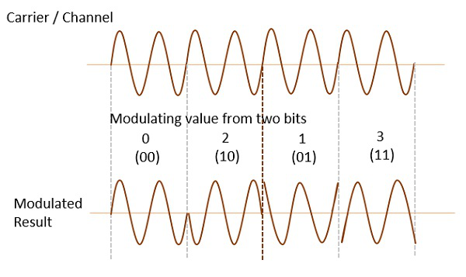
Quadrature Phase Shift Keying(QPSK)
This is the phase shift keying method, in which the sine wave carrier profits four phase reversals such as 0°, 90°, 180°, and 270°.
If this kind of methods is further prolonged, PSK can be completed by eight or sixteen values also, liable upon the necessity. The resulting figure signifies the QPSK waveform for two bits input, which displays the modulated result for different examples of binary inputs.

Slide 7
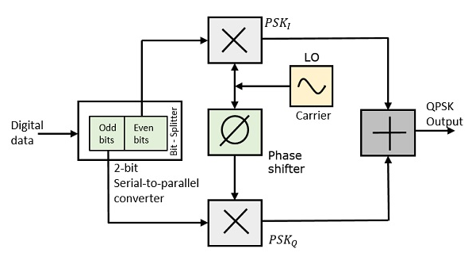
QPSK Modulator
The QPSK Modulator uses a bit-splitter, two multipliers with local oscillator, a 2-bit serial to parallel converter, and a summer circuit. Following is the block diagram for the same.

Slide 8
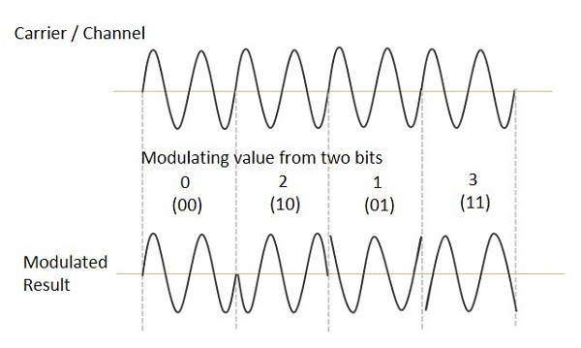
At the modulator’s input, the message signal’s even bits (i.e., 2nd bit, 4th bit, 6th bit, etc.) and odd bits (i.e., 1st bit, 3rd bit, 5th bit, etc.) are separated by the bits splitter and are multiplied with the same carrier to generate odd BPSK (called as PSK_{I}) and even BPSK (called as PSK_{Q}). The PSK_{Q} signal is anyhow phase shifted by 90° before being modulated.
The QPSK waveform for two-bits input is as follows, which shows the modulated result for different instances of binary inputs.

Slide 9
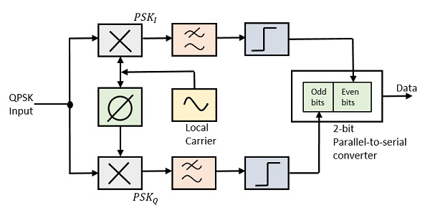
QPSK Demodulator
The QPSK Demodulator uses two product demodulator circuits with local oscillator, two band pass filters, two integrator circuits, and a 2-bit parallel to serial converter. Following is the diagram for the same.
The two product detectors at the input of demodulator simultaneously demodulate the two BPSK signals. The pair of bits are recovered here from the original data. These signals after processing, are passed to the parallel to serial converter.

Slide 10
Applications of QPSK
• Similar to BPSK, QPSK is used in various cellular wireless standards such as GSM, CDMA, LTE, 802.11 WLAN, 802.16 fixed and mobile WiMAX, Satellite and CABLE TV applications.
• As difference between any two constellation point is 90 degree maximum, QPSK modulation type has many benefits. It is robust compare to other modulation techniques except BPSK.
• It has double data rate carrying capacity compare to BPSK as two bits are mapped on each constellation points. In BPSK only 1 bit is mapped to each constellation point.

Slide 11
Advantages & disadvantages of QPSK
Advantages of QPSK:
QPSK provide very good noise immunity
It provides low error probability
Bandwidth is twice efficient is compared to BPSK modulation
For the same BER, the bandwidth required by QPSK is reduced to half as compared to BPSK
It is more efficient utilization of the available bandwidth of the transmission channel
Carrier power almost remains constant because of OQPSK amplitude is not much

Slide 12
Disadvantages of QPSK:
QPSK is not more power efficient modulation technique compare to other modulation types as more power is required to transmit two bits
QPSK is more complex compared to BPSK receiver due to four states needed to recover binary data information

Slide 13
Conclusion
Compared to modulation schemes that transmit one bit per symbol, QPSK is advantageous in terms of bandwidth efficiency. For example, imagine an analog baseband signal in a BPSK (binary phase shift keying) system. BPSK uses two possible phase shifts instead of four, and thus it can transmit only one bit per symbol.
Quadrature phase shift keying (QPSK) is another modulation technique, and it’s a particularly interesting one because it actually transmits two bits per symbol. In other words, a QPSK symbol doesn’t represent 0 or 1—it represents 00, 01, 10, or 11.
QPSK system can use a baseband signal of the same frequency, yet it transmits two bits during each symbol period. Thus, its bandwidth efficiency is (ideally) higher by a factor of two.

Slide 14
Thank You !!

